Slide 1
Introduction to Social Network Analysis: Part 1
Melissa Whatley, PhD
Belk Center for Community College Leadership and Research
North Carolina State University
Spring 2021

Slide 2
Part 1
What is network analysis?
Key terminology
Network data and issues in data collection
Centrality measures
Drawing a network

Slide 3
What is network analysis?
Relationships are the fundamental unit of social analysis (Emirbayer, 1997)
The social world does not consist of independent, static actors, but rather social entities that build connections.
The goal of network analysis is to capture the structure of networks and consequently enhance our understanding of actions taken by different groups of social actors (Wasserman & Faust, 1994).
Three examples

Slide 4
The Strength of Weak Ties (Granovetter, 1974)
How do people learn about job opportunities?
Information about job opportunities was more likely to be obtained from “weak ties” rather than strong ones.

Slide 5
Is Voting contagious? (Nickerson, 2008)
Field experiment: Two get-out-the-vote campaigns
How does the voting behavior of other people in your household relate to your own voting behavior?
60% increased propensity to vote

Slide 6
Birth of the renaissance state in Italy (Padgett & Ansell, 1993)
Premise: Medici political control was produced by network disjunctures that only that family spanned.
Cosimo de’ Medici
Relations in peoples’ actual lives are the building blocks of state formation.

Slide 7
Other examples
Network neuroscience (e.g., connections in the brain)
Biological networks (e.g., interactions among molecules)
Transportation networks (e.g., finding efficient bus routes)
Crime networks (e.g., terrorist networks)

Slide 8
terminology
Node/Vertex
Edge/Link/Tie (can be weighted or unweighted)
Directed/Undirected Networks
Attribute: Another characteristic of a node (e.g., if your nodes are people, maybe gender, race/ethnicity, socioeconomic status, etc.)

Slide 9
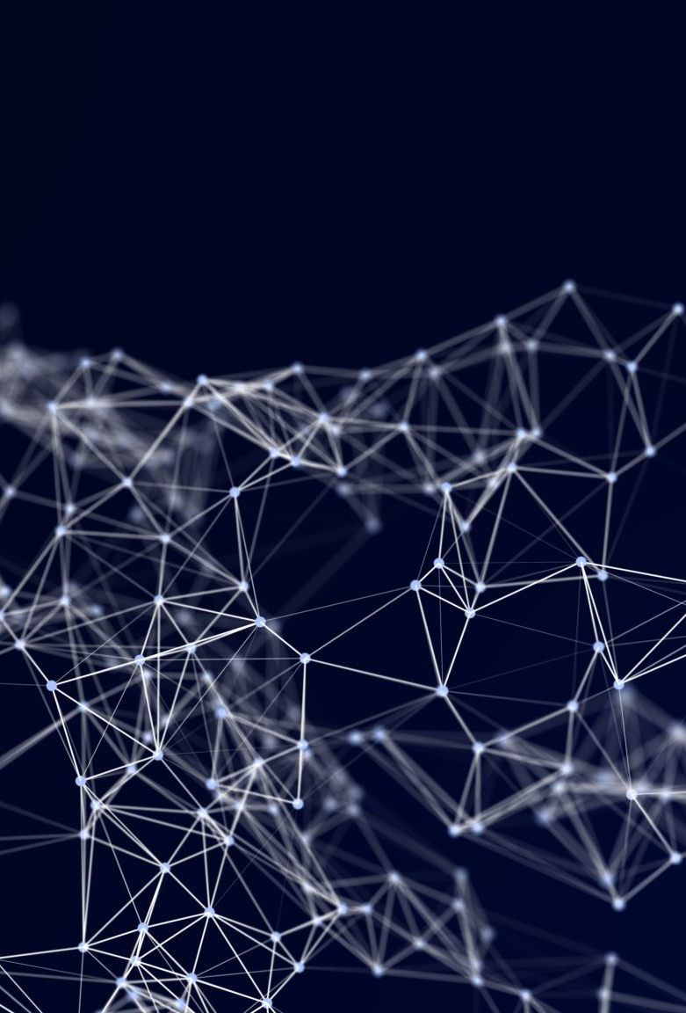
Network Data

Slide 10
Network Data
One-mode networks:
All actors come from the same set (e.g., students at a university)
Two-mode networks:
Actors come from different sets (e.g., non-profit organizations and the entities that benefit)
A special case: Affiliation networks

Slide 11
Network data
Structural variables:
What are the ties in a network like? (e.g., business transactions, friendships, trade between different countries)
Composition variables:
Measurements of actor attributes (e.g., profits of a business, participation in certain educational activities, number of employees)

Slide 12
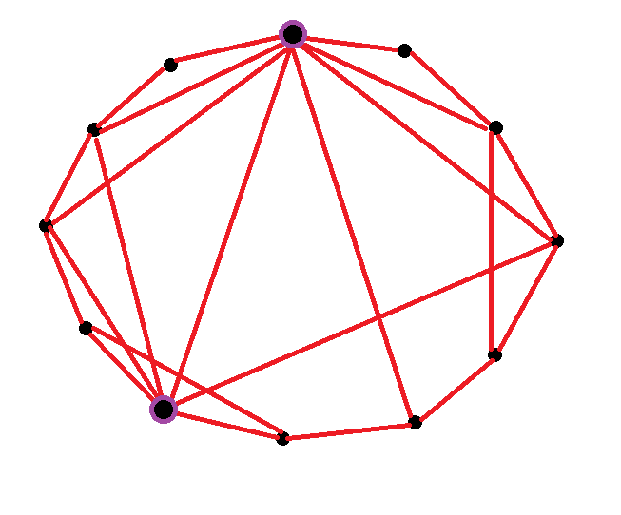
How to collect network data?
Questionnaires
E.g., free recall, rankings, free recall or choice
Interviews
Similar to questionnaires, but when oral data collection is more appropriate
Observations
E.g., interaction patterns among people
Archival records
E.g., political interactions among nations, memberships in organizations/clubs/etc.
Experiments
E.g., manipulations of who is allowed to interact with who
Other techniques: Diaries, ego-centered, small world
Information about the interactions of a single person
An individual’s record of who they interact with - Six degrees of Kevin Bacon (https://oracleofbacon.org/)
A given node isn’t likely to be neighbors to everyone, but neighbors are likely neighbors (small world)

Slide 13
Issues in network data collection
Accuracy: Can you remember everyone that you interacted with last week?
Validity: Is your definition of “friendship” the same as your neighbor’s? Are there people in your life who blur the lines between friend and colleague?
Reliability: If I asked you today to list your five best friends, would your answer be the same as a week ago?
Measurement error: If I ask you to “list your three best friends”, would that be an exhaustive list of your best friends?

Slide 14
Issues in network data collection
Ethical issues
Informed consent from individuals who are mentioned by other individuals
Individuals who are observed, but not part of your population of interest
How do we know when a network is “complete”? Our definitions of boundaries are sometimes arbitrary.

Slide 15
Centrality Measures

Slide 16
Centrality measures
Characteristics of the network tell us something about the movement of things (e.g., information, diseases, power) within the network.
How is a graph organized around its most central points?
Degree centrality
Closeness centrality
Betweenness centrality
Eigenvector centrality

Slide 17
Degree centrality
The number of ties that involve a given node
In directed graphs:
In-degree centrality
Out-degree centrality

Slide 18
Closeness centrality
Inverse of the sum of the distances to all other nodes
For example, the time of arrival of a piece of information (like in a gossip network)
Examples:
Node B: 1/14 (0.07)
Node E: 1/16 (0.06)
Node J: 1/29 (0.03)
Note that three nodes (B, E, and G) have the highest degree centrality.
Node B: 1+1+2+1+2+1+1+2+3=14

Slide 19
Betweenness centrality
The number of times that a node acts like a “bridge” between two other nodes.
Alice can pass information between:
Mark and Bridget
Mark and Doug
Mark and Charles
Charles can pass information between:
Alice and Michael
Doug, Bridget, and Michael receive information, but they don’t pass it on to anyone else.
Mark doesn’t receive information from anyone.

Slide 20
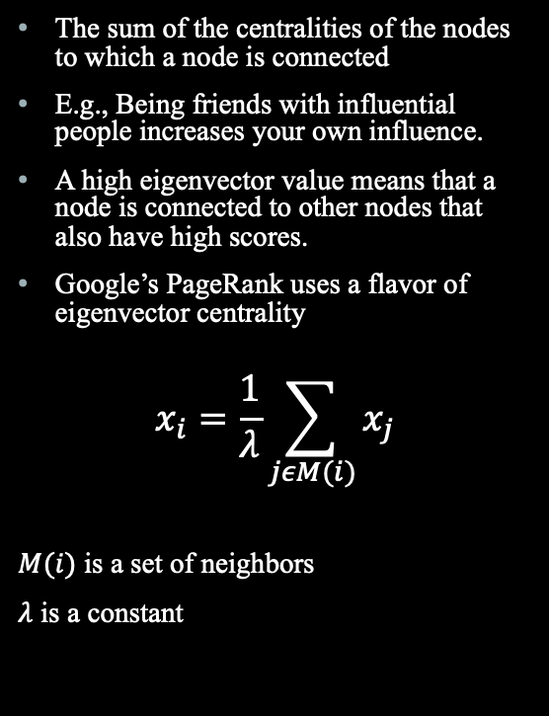
Eigenvector centrality
The sum of the centralities of the nodes to which a node is connected
E.g., Being friends with influential people increases your own influence.
A high eigenvector value means that a node is connected to other nodes that also have high scores.
Google’s PageRank uses a flavor of eigenvector centrality
$$x_{i}=\frac{1}{λ}\sum_{jεM(i)}{x_{j}}$$
$M(i)$ is a set of neighbors
$λ$ is a constant

Slide 21
Reading recommendations
Wasserman, S., & Faust, J. (1994). Social network analysis: Methods and applications. Cambridge University Press.
Scott, J. (2013). Social Network Analysis. Sage.
González Canché, M.S. (2019). Geographical, statistical, and qualitative network analysis: A multifaceted method-bridging tool to reveal and model meaningful structures in education research. Higher Education: Handbook of Theory and Research.
Has R code that follows along with examples
Next Tuesday: Peer Effects

Slide 22
Practice: An advice network
The file edgelist.csv contains information about an advice network.
The column “from” indicates who is asking advice
The column “to” indicates who is providing advice
The column “weight” accounts for how many times a week the exchange happens

Slide 23
Practice: An advice network
Set your working directory
Load the packages you’ll need for this practice activity (igraph, RColorBrewer, classInt)
Load the edgelist that I’ve given you (edgelist.csv)
Store the edgelist as a graph
Get centrality measures for all the actors in the advice network
Which actors have the highest values for each centrality measure? What do these differences tell us about the role of these actors in the network?
Create a visualization of the network that illustrates how individuals act as “bridges” within the network. Make the nodes of your network blue.

